Slide 1
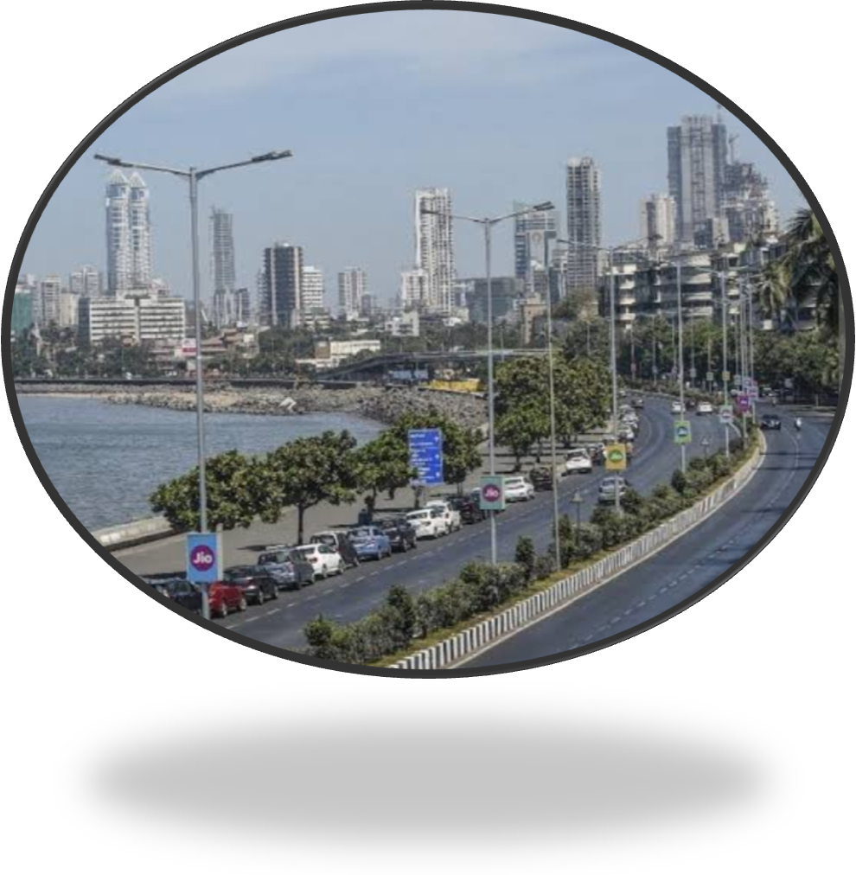
ROAD TRANSPORT AND COMMUNICATION

Slide 2
By the students of Department of Statistics, Mumbai University
By the students of Department of Statistics, Mumbai University
Sr.no | Name | Roll.No
1 | Sana Kazi | 18
2 | Rutika Khaire | 19
3 | Mrunali Patil | 29
4 | Ekta Shirsulla | 40

Slide 3
INTRODUCTION 1) Road transport is a fundamental component of our infrastructure. 2) Letter boxes and posts serve as a key component in the exchange of information 3)Transportation sectors include a list of factors affecting like the no of passenger, no of the vehicles plying on the road, etc. 4) In our data, Bus transportation and its types is the main vehicle considered for Table 7.4

Slide 4
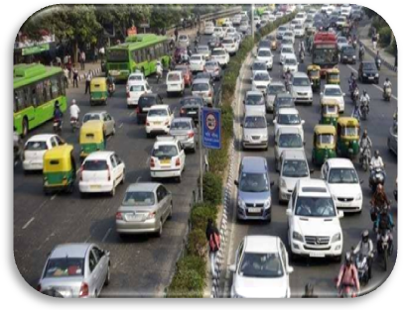

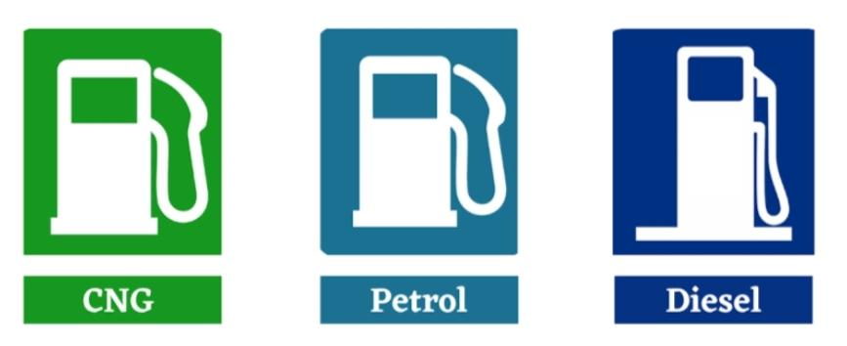
Analysis on Number of motor vehicles and license holders in Maharashtra state.

Slide 5
ABOUT DATA:
Passenger vehicles | Goods transport vehicles | License holders
The buses | Three wheels | Light vehicles
Cars and station wagons | Four wheels | Heavy vehicles
Jeep | Tractors | Auto-rickshaw
Taxi | Attachment vehicles
Three wheeler vehicles(Auto-rickshaws) | Others
A) Three seater
B) Six seater
Two wheeled vehicles
Ambulances
School buses

Slide 6
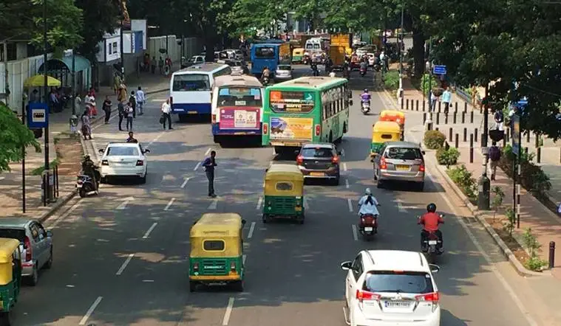
Part A: Number of vehicles in Maharashtra

Slide 7
The pie chart consists of the total number of vehicles that run on diesel, petrol, CNG/LPG for all five years. From the pie chart, we can observe that maximum number of vehicles that is about 81% of vehicles in Maharashtra run on petrol.

Slide 8
The alongside chart is the column chart which depicts division wise distribution of fuel type in Maharashtra amongst which Pune division is the highest in petrol type fuel, Konkan is the second highest division and lowest division is Amravati in petrol type fuel. In diesel fuel type, highest division is Konkan followed by Pune.
Fuel type | Highest | Lowest
Diesel | Konkan | Amravati
Petrol | Pune | Amravati
CNG/LPG | Konkan | Nagpur

Slide 9
THE DISTRIBUTION OF TOTAL VEHICLES IN MAHARASHTRA BY DIVISIONS
Pune division has the highest number of vehicles in Maharashtra followed by Konkan and Nashik divisions.
In Pune division, Pune district has the maximum number of vehicles followed by Sangli, Kolhapur districts. The lowest number of vehicles is in Solapur district.

Slide 10
The alongside graph is a line chart of total number of vehicles in Pune district which includes 5 years. We can see significant increasing trend in total vehicles.
In Konkan division, the maximum number of vehicles is in Mumbai city followed by thane and the lowest is in Sindhudurg district.

Slide 11
TOTAL GOODS TRANSPORT VEHICLES IN MAHARASHTRA

Slide 12
Research Question 1: To investigate What happens to 1 scale variable (passenger vehicles) when the other scale variable (goods transport vehicle) increases? Does it increase too or decrease or roughly remains the same? r = -0.477
Correlations
 |  | passenger vehicles | goods_transport_vehicles
passenger vehicles | Pearson Correlation | 1 | -.477**
 | Sig. (2-tailed) |  | .000
 | N | 177715827 | 177715827
goods_transport_vehicles | Pearson Correlation | -.477** | 1
 | Sig. (2-tailed) | .000
 | N | 177715827 | 177715827
**. Correlation is significant at the 0.01 level (2-tailed).

Slide 13
Case Processing Summary
 | fuel_type | Cases
 |  | Valid |  | Missing |  | Total
 |  | N | Percent | N | Percent | N | Percent
passenger_vehicles | Disel | 30 | 100.0% | 0 | 0.0% | 30 | 100.0%
 | Petrol | 30 | 100.0% | 0 | 0.0% | 30 | 100.0%
 | CNG/LPG | 30 | 100.0% | 0 | 0.0% | 30 | 100.0%
Research Question 2: Does the passenger vehicles differ significantly by fuel type?
H0: There is no significant difference between three types of fuel. VS H1: There is significant difference between three types of fuel.
ASSUMPTION CHECKING OF NORMALITY
H0: Data is normally distributed.
VS
H1: Data is not normally distributed.
We reject H0 at 5% L.O.S .
Tests of Normality
 | fuel_type | Kolmogorov-Smirnovª |  |  | Shapiro-Wilk
 |  | Statistic | df | Sig. | Statistic | df | Sig.
passenger_vehicles | Disel | .218 | 30 | .001 | .830 | 30 | .000
 | Petrol | .207 | 30 | .002 | .870 | 30 | .002
 | CNG/LPG | .319 | 30 | .000 | .637 | 30 | .000
a. Lilliefors Significance Correction

Slide 14
NONPARAMETRIC FOR ONE WAY ANOVA – KRUSKAL WALLI’S TEST H0: The medians of three population are equal i.e. M1=M2=M3 VS H1: The medians of three populations are not equal i.e. M1≠M2≠M3. Since P value < 0.05, we reject H0 at 5% L.O.S We conclude that Medians of 3 population are not equal.
Hypothesis Test Summary
 | Null Hypothesis | Test | Sig.^{a,b} | Decision
1 | The distribution of passenger_vehicles is the same across categories of fuel_type. | Independent-Samples Kruskal-Wallis Test | .000 | Reject the null hypothesis.
a. The significance level is .050.
b. Asymptotic significance is displayed.
Ranks
 | fuel_type | N | Mean Rank
passenger_vehicles | Disel | 30 | 40.60
 | Petrol | 30 | 75.50
 | CNG/LPG | 30 | 20.40
 | Total | 90
Test Statistics^{a,b}
 | passenger_vehicles
Kruskal-Wallis H | 68.309
df | 2
Asymp. Sig. | .000
a. Kruskal Wallis Test
b. Grouping Variable: fuel_type

Slide 15
Pairwise comparison of fuel type Since P value for all three pairs is less than 0.05, we reject null hypothesis at 5% L.O.S All three pairs are statistically significant.
PAIRWISE COMPARISONS OF FUEL_TYPE
Sample 1-Sample 2 | Test Statistic | Std. Error | Std. Test Statistic | Sig. | Adj. Sig.ª
CNG/LPG-Disel | 20.200 | 6.745 | 2.995 | .003 | .008
CNG/LPG-Petrol | 55.100 | 6.745 | 8.169 | .000 | .000
Disel-Petrol | -34.900 | 6.745 | -5.174 | .000 | .000
Each row tests the null hypothesis that the Sample 1 and Sample 2 distributions are the same. Asymptotic significances (2-sided tests) are displayed. The significance level is .050.
a. Significance values have been adjusted by the Bonferroni correction for multiple tests.

Slide 16
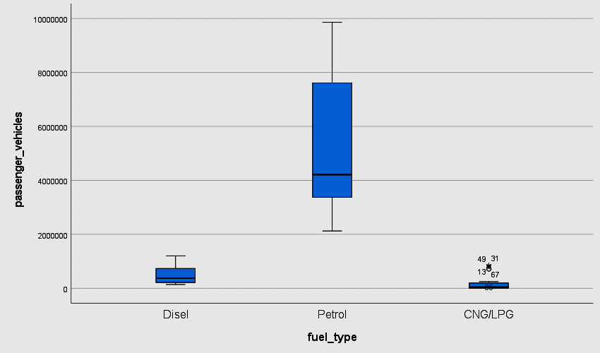
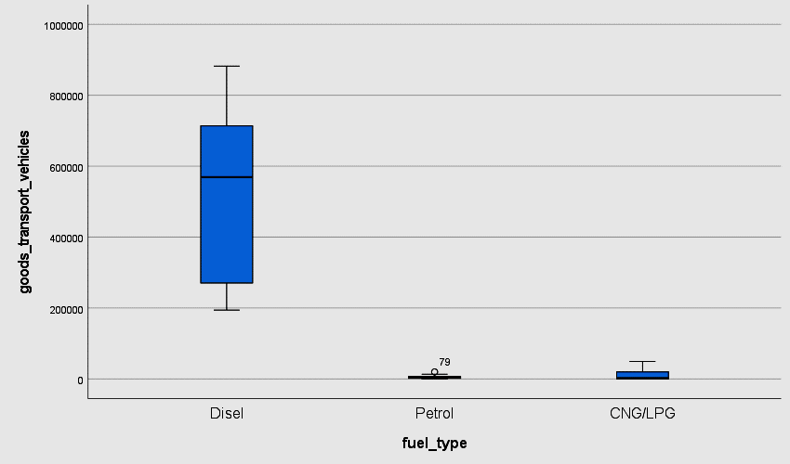
Research Question 3: How to detect an outlier?

Slide 17
PART B : License holders in Maharashtra

Slide 18
The doughnut chart shows the division wise share of license holders in Maharashtra. We can clearly observe that Pune division holds rank 1 with 46% of total share followed by Konkan division. The least can be seen in Nagpur division.

Slide 19
From column chart we can notice that Pune district has the maximum number of license holders and the least is in Solapur district.

Slide 20
The alongside graph shows the year wise trend in number of license holders in Pune district. We can observe an increasing trend in all 5 years.

Slide 21
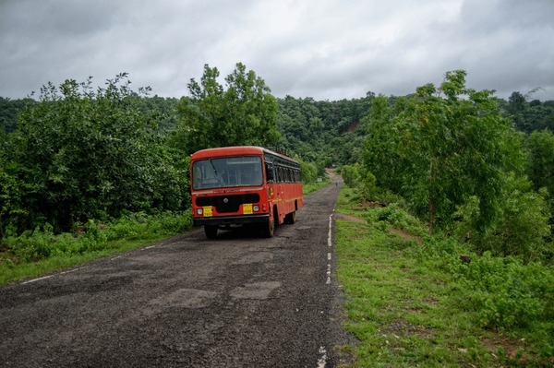
Analysis on daily average no of buses plying on the road

Slide 22
Visual Representation:
The graph illustrates significant variations in the daily average number of buses operating across different divisions in Maharashtra over a five-year period. Each division exhibits a distinct trend and overall, a general decrease in bus operations is evident by 2021, likely due to impacts from external factors such as the COVID-19 pandemic. The year 2022 shows a partial recovery, with further improvements into 2023, suggesting a resilience in the transportation sector.
Daily average no of buses plying on the road is highest in Pune region (2019) and lowest in Nagpur (2022).

Slide 23
Highest Division: Pune
The yellow highlighted region shows highest total average no of buses plying on the road.
This region is Pune district having 23%.
Lowest Division: Nagpur
The pie diagram shows detail graph over Nagpur division
Gondia district is least in all 5 years.

Slide 24
Analysis on daily average no of passengers (in lakhs)
Usage level and demand for bus services in each district.
Highest Division:
Pune
Lowest Division:
Amravati and Nagpur
During the year 2019-2023 Kolhapur district is leading. Pune district leading in 2021 and 2022.
Gondia district is least in 2019-2021 & 2023 years..In the year 2022 there are two districts.Washim and Gondia showing same behaviour.

Slide 25
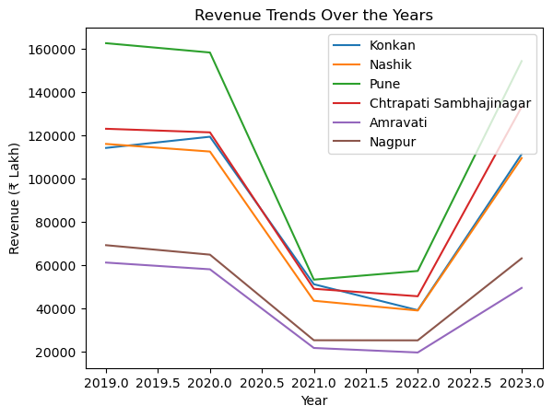
Analysis Using Python For Revenue generated from transportation during the year 2019-2023 :
Conclusion:
The trend analysis indicates that while all divisions experienced a significant decline in revenue in 2021, most divisions show a strong recovery trend in 2022 and 2023. However, the extent of recovery varies across divisions, with some divisions like Pune and Chtrapati Sambhajinagar showing a more robust recovery compared to others like Nashik and Nagpur. The observed trends suggest that external factors likely affected the revenues in 2021, but there is a positive trend towards recovery in the subsequent years.

Slide 26
Transport activities of local bodies: This includes factors discussing about the : Daily average of total distance travelled by passengers during the year. Average number of passengers per day Average number of daily buses used for transport services Local self government bodies Contractors Others Net Profit / Loss Lets have a look on the different types of the Transport services in the following regions

Slide 27
Pune Region:
As per the data, as the year changes from 2019 to 2023 the number of Local self government transport vehicles decreases while no of contractor vehicles increases.
Mumbai Suburban:
For Mumbai suburban the different transportation vehicle number fluctuate highly with the change year.

Slide 28
MUMBAI CITY:
For Mumbai City as the year changes from 2019 to 2023 the number of Local self government transport vehicles decreases while no of contractor vehicles increases . Other number of vehicle is also shown in the pie chart.

Slide 29
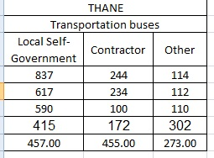
Analysis:
Is there any significant
difference between the
types of transportation
buses available?
For further analysis firstly we will check
whether data is normal or not.

Slide 30

To check the data is normal or not?
We plot the histogram
Using excel. As we can
The results show the
Barplots are resembles
Bell shapes.
Therefore, data is normal.

Slide 31
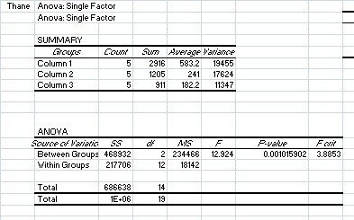
Performing One Way Anova:
Ho: There is no significant difference between the types of the bus transportation available
VS
H1: There is significant difference between the types of the bus transportation available
Results:
As the p-Value = 0.0010 < 0.05
WE REJECT Ho
There is significant difference between the types of the bus transportation available

Slide 32
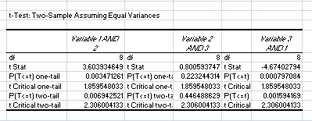
Types of bus transportation available is significant
Perform POST-HOC ANALYSIS

Slide 33
RESULTS:
TYPES | P-value | Significant
V1V2 | 0.003 | YES
V2V3 | 0.2232 | NO
V3V1 | 0.0007 | YES
Alpha= 0.05
Bonferroni Coefficient = alpha/3 = 0.0167
Conclusion: Variable 1 and 2 and Variable 1 and 3 are pairwise significant.

Slide 34
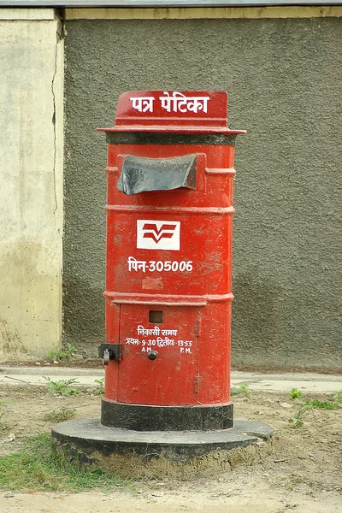
The Maharashtra Postal and Telecommunication Service
The Maharashtra Postal and Telecommunication Service plays a vital role in connecting people and facilitating communication across the state. From traditional mail delivery to modern telecommunications, it serves as a lifeline for residents and businesses alike. Maharashtra’s extensive postal network ensures the efficient delivery of mail and packages, while its telecommunication infrastructure enables seamless connectivity through landlines, mobile phones, and internet services. Together, these services contribute to the socio-economic development and connectivity of Maharashtra’s diverse population.

Slide 35
Data Overview The provided data appears to be a detailed record of postal infrastructure and telecommunications facilities across various districts in Maharashtra over several years, ranging from 2019 to 2023.
YEAR | No. of posts | No. of letter-boxes | No. of postmen | No. of villages with postal facility | Personal telephone number |  | No. of personal telephone numbers | No.of public telephone centers
 |  |  |  |  | rural | civilian
2019 | 12625 | 37734 | 11361 | 25079 | 158775 | 3140201 | 3293198 | 90538
2020 | 12428 | 36194 | 11122 | 25569 | 114629 | 2847225 | 2961854 | 27382
2021 | 12594 | 36408 | 12274 | 26534 | 103106 | 3716586 | 3819692 | 36348
2022 | 12724 | 36010 | 12567 | 26018 | 68052 | 3234817 | 3302869 | 26025
2023 | 13193 | 36043 | 13094 | 26161 | 121091 | 2790869 | 2911960 | 18597

Slide 36
Number of Letter Boxes and Postmen in Maharashtra (2019-2023)
The number of letterboxes in Maharashtra increased slightly from 12,625 in 2019 to 13,193 in 2023. This represents a growth of about 4.5%.
A bar graph shows the number of letterboxes each year. The number of letterboxes has fluctuated slightly but there is a small upward trend.
The number of postmen in Maharashtra appears to have fluctuated slightly over the same period. There were 37,734 postmen in 2019 and 36,043 in 2023. This represents a decrease of about 4.5%.
A bar graph (see below) shows the number of postmen each year. The number of postmen has fluctuated slightly more than the number of letterboxes. There is no clear upward or downward trend.

Slide 37
Number of Rural and Civilian Telephone Connections in Maharashtra (2019-2023)
The data shows a significant difference between the number of rural and civilian connections. Civilian connections are consistently much higher than rural connections.
A bar graph shows the number of rural and civilian connections annually. The number of connections for both categories has increased over the five years.
The number of rural connections increased by about 23.4% from 2019 to 2023 (from 158,775 to 196,849).
The number of civilian connections increased by about 12.4% from 2019 to 2023 (from 3,140,201 to 3,529,425).

Slide 38
Personal and Public Telephones
• The number of personal telephones is generally higher than the number of public telecenters across all years.
• However, the gap between the two varies. For example, in 2019, there are around 3293198 personal telephones compared to around 90,538 public telephone centers, while in 2023, the gap narrowed with around 2911960 personal telephones and around 18,597 public telephone centers.

Slide 39
Pune seems to have consistently recorded the highest volume of posts, ranging from 2,966 to 2,976 across the years. On the other hand, Amaravati and Aurangabad appear to have had the lowest posting activity, with figures between 1,387 and 2,202 throughout the period.
Konkan and Nashik exhibit a pattern of relative consistency in post volume, ranging from approximately 2,100 to 2,350 posts annually.
Number of Letterboxes: There seems to be a decrease in the number of letterboxes in all regions between 2019 and 2023.
Number of Postmen: Similar to letterboxes, there appears to be a decrease in the number of postmen across all regions during the five years.

Slide 40
Correlation Between Public Telephone Centers and Posts
Public Telephone Centers (PCOs) are facilities where people can make telephone calls, often serving rural or urban areas. In the context of postal services, PCOs might be an indicator of infrastructure investment and communication availability in a region. It’s plausible that an increase in the number of PCOs could reflect better connectivity and communication infrastructure, potentially impacting the efficiency or volume of postal services.
Hypothesis Formulation
Null Hypothesis (H0): There is no significant correlation between the number of Public Telephone Centers (PCOs) and the number of posts
Alternative Hypothesis (H1): There is a significant correlation between the number of Public Telephone Centers (PCOs) and the number of posts, specifically a positive correlation.
To test this hypothesis, we can perform a linear regression analysis where the number of posts is the dependent variable and the number of PCOs is the independent variable.

Slide 41
Result:
Call:
lm(formula = Number_of_posts ~ Number_of_PCOs, data = data)
Residuals:
Min 1Q Median 3Q Max
-252.03 -164.36 -24.42 112.62 458.85
Coefficients:
Estimate Std. Error t value Pr(>|t|)
(Intercept) 358.043227 14.232976 25.156 <2e-16 ***
Number_of_PCOs -0.004443 0.002346 -1.894 0.0598
Residual standard error: 187.8 on 178 degrees of freedom
Multiple R-squared: 0.01976, Adjusted R-squared: 0.01425
F-statistic: 3.588 on 1 and 178 DF, p-value: 0.05981
Decision criteria:
The p-value for the coefficient of Number_of_PCOs is 0.0598.
0.0598 > 0.05, we fail to reject the null hypothesis. This shows that while there is a negative association between Number_of_PCOs and Number_of_posts, this relationship is not statistically significant at the 0.05 level.

